Slide 1
Z. Gu
CSC175 Spring 2026 Sample Exam Questions
Spring 2026

Slide 2
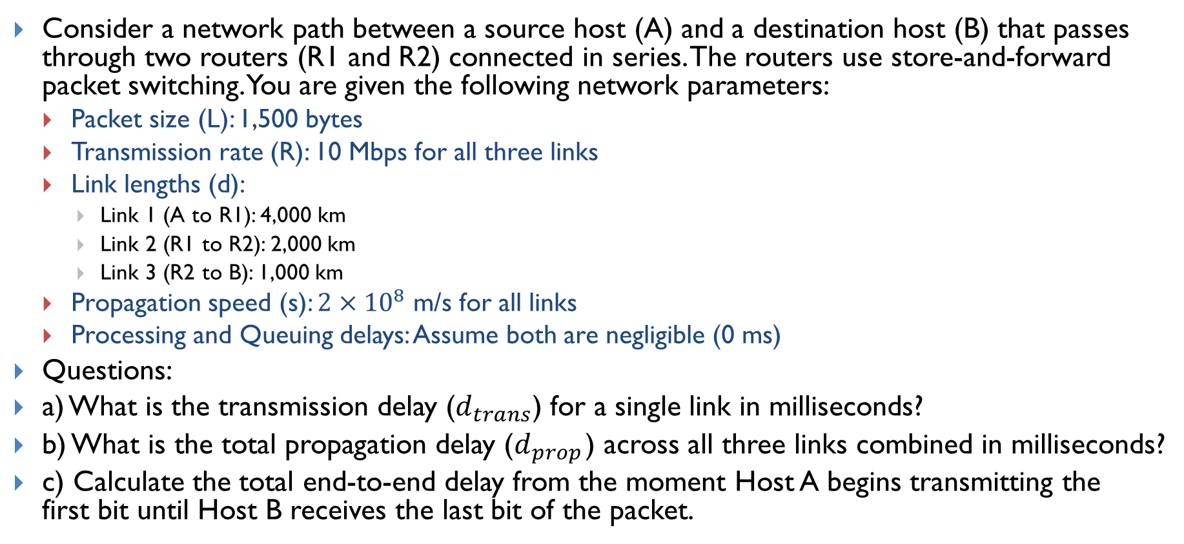
Lecture 3 - Links
Consider a network path between a source host (A) and a destination host (B) that passes through two routers (R1 and R2) connected in series. The routers use store-and-forward packet switching. You are given the following network parameters:
Packet size (L): 1,500 bytes
Transmission rate (R): 10 Mbps for all three links
Link lengths (d):
Link 1 (A to R1): 4,000 km
Link 2 (R1 to R2): 2,000 km
Link 3 (R2 to B): 1,000 km
Propagation speed (s): $2×{10}^{8}$ m/s for all links
Processing and Queuing delays: Assume both are negligible (0 ms)
Questions:
a) What is the transmission delay ($d_{trans}$) for a single link in milliseconds?
b) What is the total propagation delay ($d_{prop}$) across all three links combined in milliseconds?
c) Calculate the total end-to-end delay from the moment Host A begins transmitting the first bit until Host B receives the last bit of the packet.

Slide 3
Lecture 5.1 Shortest Paths Algorithms
Consider an Autonomous System with 5 routers (A, B, C, D, E) connected by bidirectional (undirected) point-to-point links. The link costs are shown in the figure:
Use Dijkstra’s Algorithm to compute the shortest path tree from the Source Router A.
List the Visit Order of the routers.
Fill out the Routing Table, keeping track of the Shortest Distance (SD) and Previous Node (PN). When a shorter path is found to a router, cross out the old value and write the new one.
B
6
3
A
2
C
5
1
1
E
D
2

Slide 4
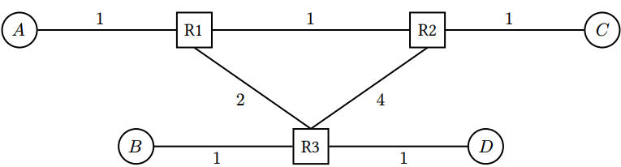
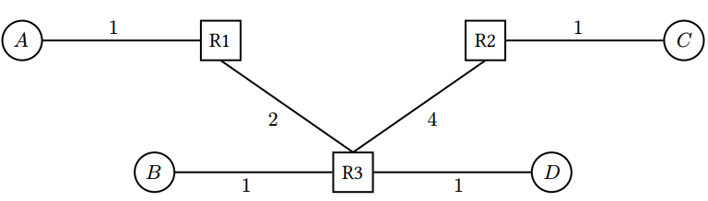
Lecture 5.2 - Distance-Vector
Alice (𝐴), Bob (𝐵), Connie (𝐶), and Diego (𝐷) are connected to the local network, which runs the distance-vector algorithm. Assumptions:
Static routes are installed at time 𝑡 = 0.
Routers send periodic advertisements every 2 seconds, starting at 𝑡 = 0. (Simplifying assumption assuming synchronized clocks for all routers.)
Routing table entries expire after TTL=10 seconds of receiving no advertisements.
Every second, each router (1) expires routes based on TTL, then (2) processes advertisements and updates its table, then (3) sends out advertisements if 𝑡 is even (every 2 seconds).
Link costs correspond to packet travel times (in seconds). Ignore processing and queuing delays.
Q1 Fill in R1’s table at steady state. If a host is directly connected, the next hop is “Direct”
After the network converges, the R1 - R2 link is broken, and split horizon is enabled on all routers.
Q2 Fill in R1’s table at the new steady state after the R1 - R2 link is broken.
Q3 Suppose R1’s original table entry for destination 𝐶 expires at 𝑡 = 20. At what time step does R1’s table reach the new steady state in Q2? Assume split horizon but no route poisoning.
Q4 Redo Q3 assuming both split horizon and route poisoning.
Notes:
• Poisoned reverse, split horizon, and route poisoning are disabled.

Slide 5
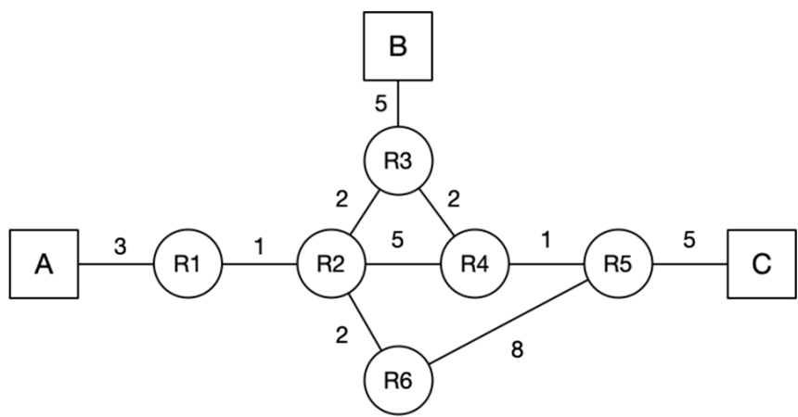
Lecture 5.3 - Link-State
Consider the following network graph with three hosts (A, B, C) and six routers (R1 - R6). For the following questions, assume that the routers run a link-state routing protocol and the routing state has converged. Every link is up unless otherwise noted. When picking between equal-cost paths, the routers pick the route through the neighbor with the lower ID number. For each answer, please provide a concise explanation.
Note that all subparts are independent questions (changes made in one subpart do not affect the subsequent ones).
Q1. Suppose that the link between R3 and R4 goes down. R3 and R4 have recomputed their routes, but they have not yet sent updates. What route will a packet from A to C take?
Q2. Suppose that the link between R2 and R3 goes down. R2 and R3 have recomputed their routes, but have not yet sent updates. What route will a packet from A to C take?
Q3. Assume that at time t=0, A sends a packet to C. At t=0.5 seconds, the link between R4 and R5 goes down, and R4 and R5 instantaneously recognize and recompute their routes. Assume that link-state advertisements are processed and propagated instantaneously. A link’s propagation delay is equal to the link costs in the diagram (in seconds), i.e. R1 - R2 has a 1-second delay, R2 - R3 has 2-second delay, etc). You can ignore all processing and queuing delays. Does the packet reach its destination? If so, write down the route the packet from A to C takes.

Slide 6
Lecture 6 - IP Addressing
Suppose hofstra.edu is the provider AS for Engineering (EE), CS, Math, and Biology, and needs to assign IPv4 addresses to them. Assume that CIDR (Classless Inter-Domain Routing) addressing is used, and that hofstra.edu has the prefix: 198.51.0.0/16. The address space is allocated as follows:
Chemistry: 198.51.0.0/18
Math: 198.51.128.0/18
The block 198.51.192.0/18 is reserved for EE and CS
The block 198.51.64.0/18 is currently unassigned
Questions
1) Which addresses are included in the Math department’s prefix? How many addresses are in this range?
2) The block 198.51.192.0/18 is reserved for EE and CS. Assign equal halves of this address space to the two departments.
3) You want to start a new department of Data Science, and assign it an unused address range. You foresee that no more than 90 people will enroll. Assuming one address per person, what prefix would you assign to minimize unused/wasted addresses?
4) After assigning the Data Science prefix, suppose Biology needs an address block for 30 people. What is the smallest unused prefix you can assign to Biology without overlapping any existing assignments?
Decimal | Binary
198 | 11000110
51 | 00110011
192 | 11000000
224 | 11100000
64 | 01000000
128 | 10000000

Slide 7
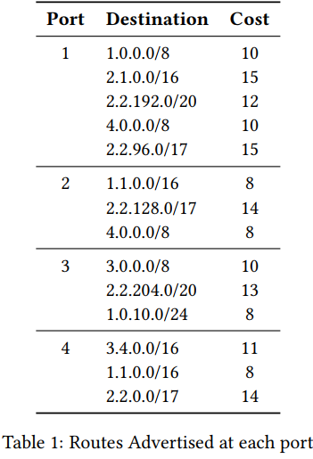
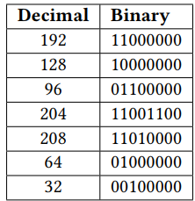
Lecture 7 - Routers
Consider a router in a network that uses a least-cost routing protocol, with ties broken by taking the route from the link with the smallest port number. The router has 4 ports and its default route sends all traffic onto port 1. Table 1 lists the routes that our router sees advertised at each port. You can find some useful binary conversions in the table below. For the following 7 subparts, determine which ports the packets with the following destinations are forwarded to based on the advertisements given above. Give brief explanation for each.
Q1 A packet with destination 3.4.0.1
Q2 A packet with destination 4.0.0.1
Q3 A packet with destination 2.2.208.1
Q4 A packet with destination 2.3.0.10
Q5 A packet with destination 2.2.204.13
Q6 A packet with destination 1.1.21.7
Q7 A packet with destination 2.2.96.22

Slide 8
Lecture 7 – Routers 2
Consider a router running longest prefix matching to forward packets.
Q1 Given the current routing table, use route aggregation to build a new table, such that both tables produce the same forwarding decisions, and every IPv4 address matches only one prefix. Write one IP prefix per box.
Destination | Port
128.1.0.0/24 | 1
128.1.1.0/24 | 2
128.1.2.0/24 | 2
128.1.3.0/24 | 3
Destination | Port
New Table

Slide 9
Lecture 7 – Routers 2
Q2 Using binary tries to run longest prefix matching. Consider building a binary trie out of a forwarding table with these three prefixes: 17.0.0.0/8, 17.1.0.0/16, 17.1.1.0/24. Draw the resulting trie. What is the height of the resulting binary trie?
Q3 Using binary tries to run longest prefix matching. Consider building a binary trie out of a forwarding table with these two prefixes: 17.0.0.0/8, 18.0.0.0/8. What is the height of the resulting binary trie? What is the earliest branching point?

Slide 10
Lecture 8 - Inter-Domain Routing
Consider the AS graph below, where each AS follows the Gao-Rexford import and export policies. For each source/destination pair, select whether it is possible for packets to be sent from the source AS to the destination AS. In other words, is there an AS path from source to destination where all intermediate ASes agree to export the path?
Q1 Source AS1, destination AS3.
Q2 Source AS1, destination AS4.
Q3 Source AS2, destination AS4.
Q4 Why is reachability not guaranteed in this AS graph?
Q5 On the graph below, draw at most 3 extra links, such that the resulting AS graph provides reachability.
AS1
AS2
AS5
AS6
AS3
AS4
Under Gao-Rexford, a route is legal if it is valley-free and respects export preference rules:
an AS may learn a route from a customer, peer, or provider;
it prefers customer routes over peer routes over provider routes;
it exports customer-learned routes to everyone, but peer/provider-learned routes only to customers.
Every intermediate AS on a legal path has at least one customer neighbor along that path.

